Slide 1
COMP 4300 Computer Architecture
Scoreboard
Dr. Xiao Qin
Auburn University
http://www.eng.auburn.edu/~xqin
xqin@auburn.edu
Notes:
43 Min: Slides 8

Slide 2
HW Scheme: Dynamic Scheduling
Static Scheduling
  Compiler techniques for scheduling
- separate dependent instructions
- minimize the number of hazard and stalls
e.g.: static branch prediction
Dynamic Scheduling
  1. Uses hardware to rearrange instructions to reduce stalls
2. Works when can’t know real dependence at compile time
3. Compiler simpler
4. Code for one pipeline runs well on another pipeline
Notes:
Question: Why use dynamic scheduling?

Slide 3


The Key idea of Dynamic Scheduling
Key Idea: Allow instructions behind stall to proceed. => Instructions executing in parallel. There are multiple execution units, so use them.
DIVD F0, F2, F4
ADDD F10, F0, F8
SUBD F12, F8, F14
  Enables out-of-order execution => out-of-order completion
ADDD stalls. Will SUBD stall?
Even though ADDD stalls, the
SUBD has no dependencies
and can run.
Dynamic pipeline scheduling overcomes the limitations of in-order pipelined execution by allowing out-of-order instruction execution.
Notes:
Mention two conditions: 1. operands are available, 2. No hardard

Slide 4
Dynamic Scheduling with a Scoreboard
The scoreboard is a centralized hardware mechanism
  In order to execute an instruction as soon as its operands are available and no hazard conditions prevent it.
It dynamically constructs the dependency graph by hardware for a window of instructions as they are issued in program order. What does a window of instructions mean?
A scoreboard is a “data structure” that provides the information necessary for all pieces of the processor to work together.
Notes:
Question: What does a window of instructions mean?

Slide 5
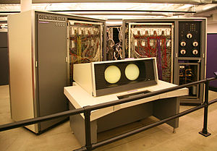
The Key idea of Scoreboards
Out-of-order execution divides ID stage: Why?
Issue—decode instructions, what hazard?
Read operands— what hazard?
Scoreboards allow instruction to execute whenever 1 & 2 hold, not waiting for prior instructions.
We will use In order issue, out of order execution, out of order commit ( also called completion)
First used in CDC6600 in 1963. Our example modified here for MIPS.
CDC had 4 FP units, 5 memory reference units, 7 integer units.
MIPS has 2 FP multiply, 1 FP adder, 1 FP divider, 1 integer.
check for structural hazards
wait until no data hazards, then read operands
Notes:
Mention: 1. Issue: WAW

Slide 6
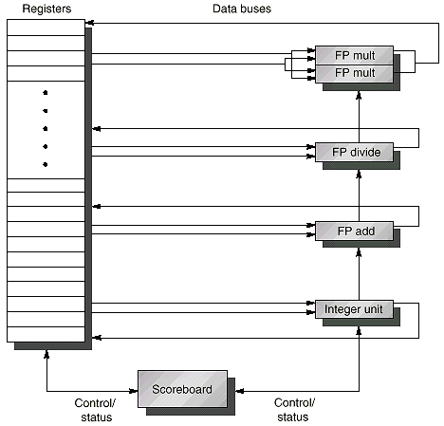
Typical Scoreboard Structure
2 FP multiply, 1 FP adder, 1 FP divider, 1 integer

Slide 7
Using A Scoreboard: 4 stages
1. Issue —decode instructions & check for structural & WAW hazards (ID1)
  If a functional unit for the instruction is free (no structural hazards) and no other active instruction has the same destination register (no WAW), the scoreboard issues the instruction to the functional unit and updates its internal data structure.
  If a structural or WAW hazard exists, then
  the instruction issue stalls, and no further instructions will issue until these hazards are cleared.
2. Read operands —wait until no data hazards, then read operands (ID2)
  A source operand is available if no earlier issued active instruction is going to write it, or if the register containing the operand is being written by a currently active functional unit (no RAW).
  When the source operands are available, the scoreboard tells the functional unit to proceed to read the operands from the registers and begin execution. The scoreboard resolves RAW hazards dynamically in this step, and instructions may be sent into execution out of order.
Always
done in
program
order
Can be
done
out of
program
order
Notes:
Why issue in prog order

Slide 8
Using A Scoreboard: 4 stages (cont.)
3. Execution — operate on operands (EX)
  The functional unit begins execution upon receiving operands. When the result is ready, it notifies the scoreboard that it has completed execution.
4. Write result — finish execution (WB)
  Once the scoreboard is aware that the functional unit has completed execution, the scoreboard checks for WAR hazards. If none, it writes results. If WAR, then it stalls the instruction.
  Example:
  DIVD F0, F2, F4
  ADDD F10, F0, F8
  SUBD F8, F8, F14
  Scoreboard would stall SUBD until ADDD reads operands
Any hazard?
Any hazard?

Slide 9
Data Structure of A Scoreboard: 3 parts
Instruction status—which of 4 steps the instruction is in
Functional unit status—Indicates the state of the functional unit (FU). 9 fields for each functional unit
Busy—Indicates whether the unit is busy or not
Op—Operation to perform in the unit (e.g., + or –)
Fi—Destination register
Fj, Fk—Source-register numbers
Qj, Qk—Functional units producing source registers Fj, Fk
Rj, Rk—Flags indicating when Fj, Fk are ready. Set to No after operands are read.
3. Register result status—Indicates which functional unit will write each register, if one exists. Blank when no pending instructions will write that register
Notes:
What you might have thought
1. 4 stages of instruction executino
2.Status of FU: Normal things to keep track of (RAW & structura for busyl):
Fi from instruction format of the mahine (Fi is dest)
Add unit can Add or Sub
Rj, Rk - status of registers (Yes means ready)
Qj,Qk - If a no in Rj, Rk, means waiting for a FU to write result; Qj, Qk means wihch FU waiting for it
3.Status of register result (WAW &WAR)s:
which FU is going to write into registers
Scoreboard on 6600 = size of FU
6.7, 6.8, 6.9, 6.12, 6.13, 6.16, 6.17
FU latencies: Add 2, Mult 10, Div 40 clocks

